Slide 1

RPG Unit Testing Made Easy in VS Code
Sanjula Ganepola
Software Developer – IBM i App Dev & AI Toolchain
Sanjula.Ganepola@ibm.com
2025 August

Slide 2
Agenda
Why Build Tooling for Unit Testing?
Basics of RPGUnit
IBM i Testing Extension Demo
How to write tests and generate test stubs?
How to run tests with code coverage?
IBM i Testing CLI Demo
How to run tests outside VS Code?
How to run tests in a CI/CD pipeline?
Code Coverage

Slide 3
Why Build Tooling for Unit Testing?

Slide 4










What is missing in the VS Code stack?
Other
watsonx Code Assistant for i
Vendor Extensions
AI Tooling
Code for IBM i
IBM i Languages
Db2 for IBM i
IBM i Renderer
CL
Source Orbit
IBM i Project Explorer
Code Coverage
RPGLE
IBM i Debug
Language Extensions
Other Tooling

Slide 5
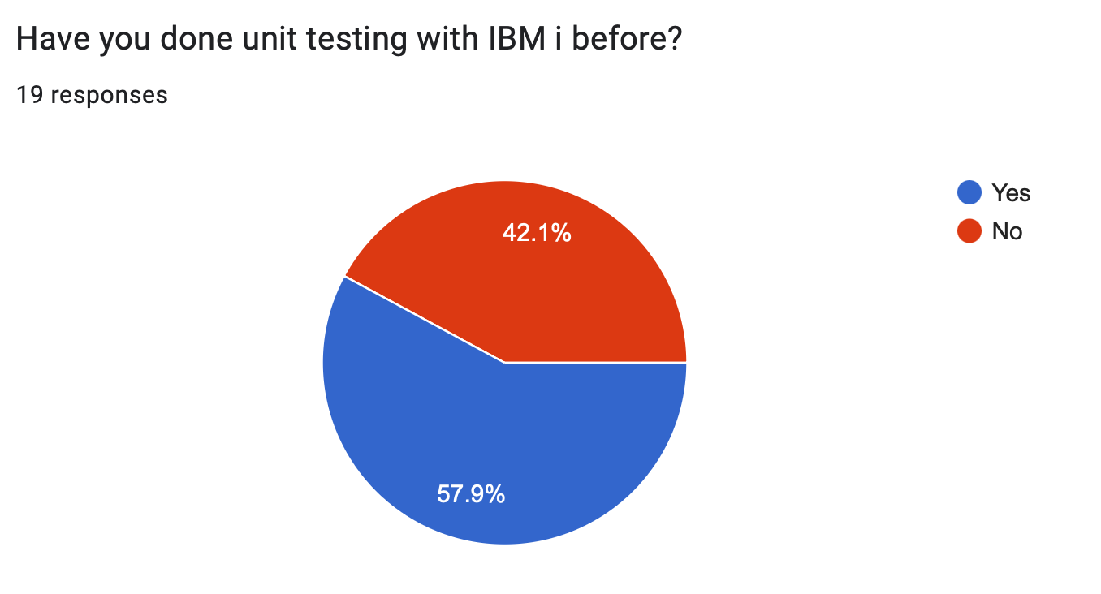
We did a survey…

Slide 6
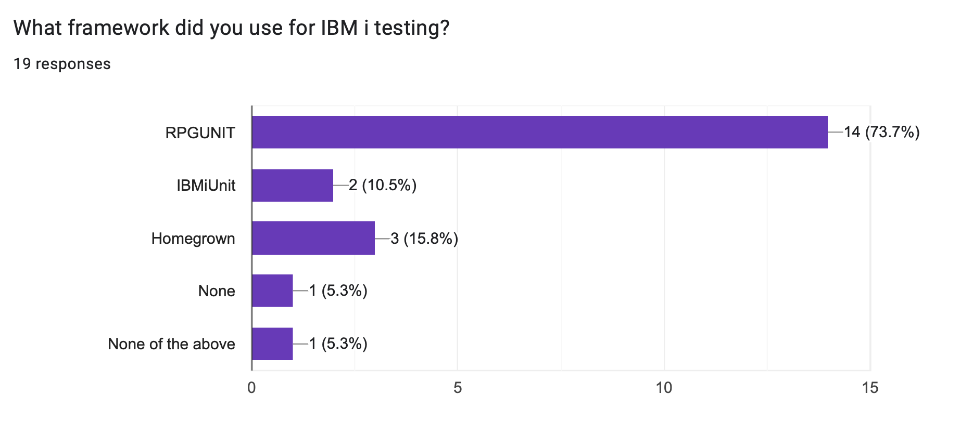
We did a survey…

Slide 7
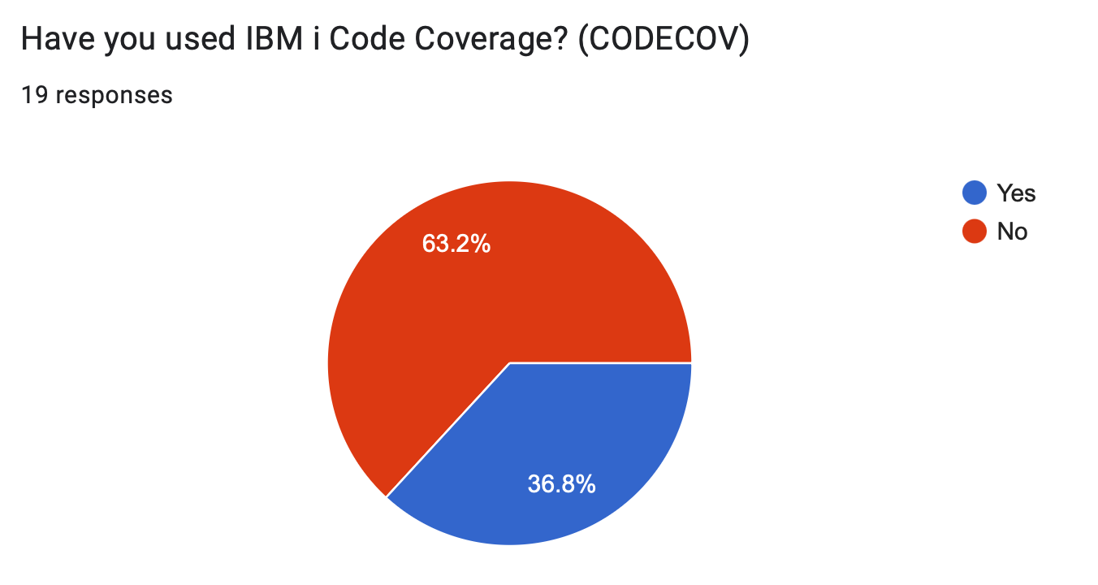
We did a survey…

Slide 8
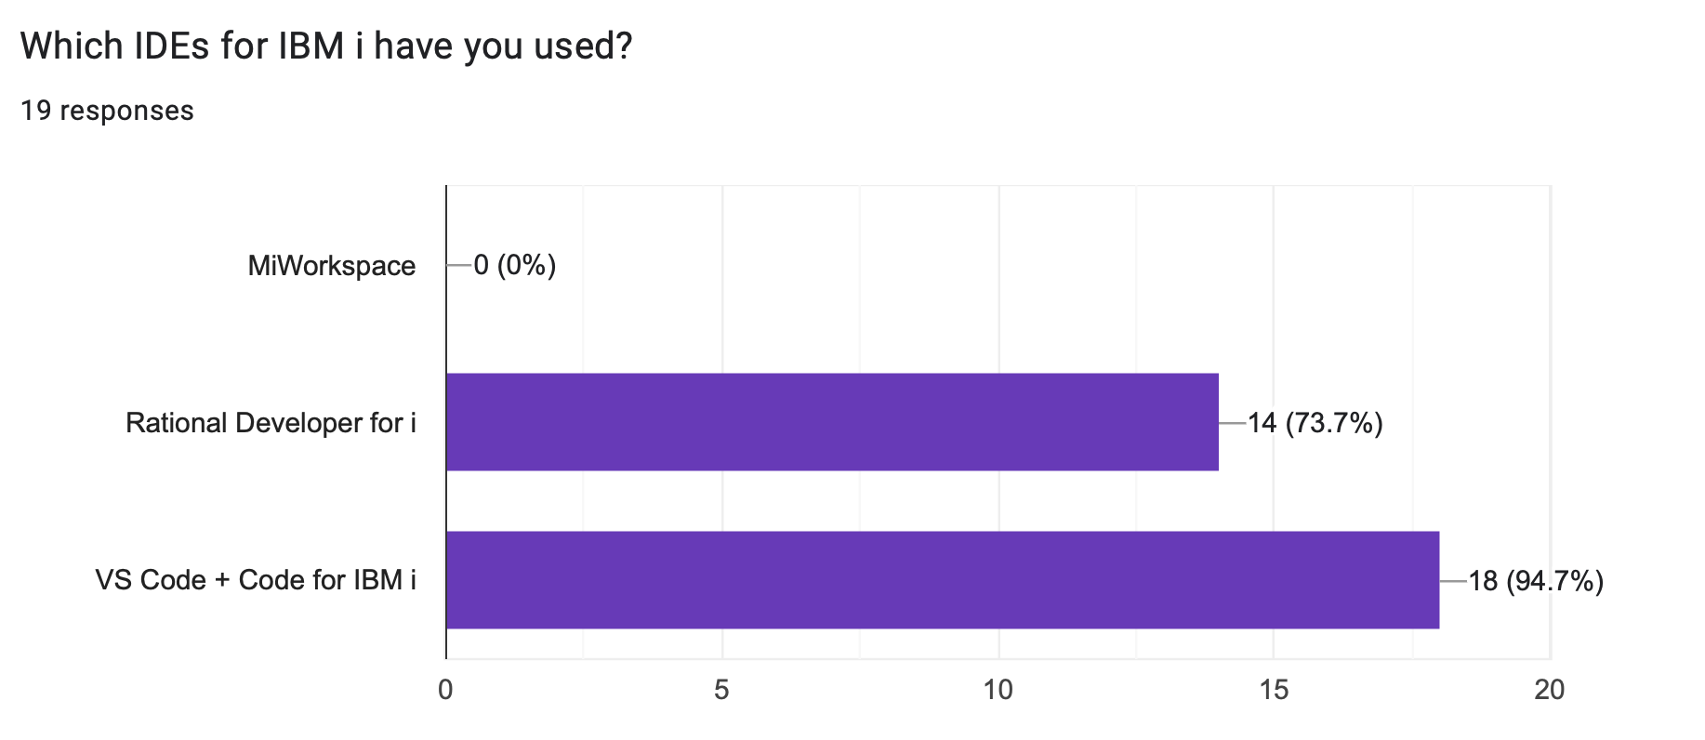
We did a survey…

Slide 9
Basics of RPGUnit

Slide 10
Naming requirements
A test case …
is an exported procedure
starts with the name test
test_getEmployeeDetail
test_getDeptDetail
testIsPalindrome
testFactorial
A test suite …
has no naming requirements
but the extension requires that …
local files are suffixed with .test.rpgle, .test.sqlrpgle, .test.cblle, or .test.sqlcblle
and recommends that …
source members are prefixed or suffixed with T, _T, T_, etc.
Code Coverage

Slide 11
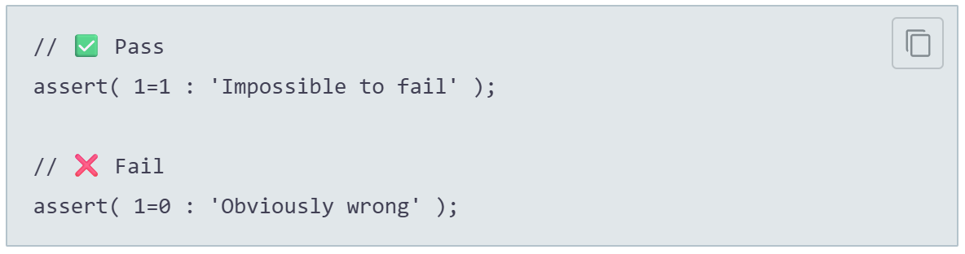
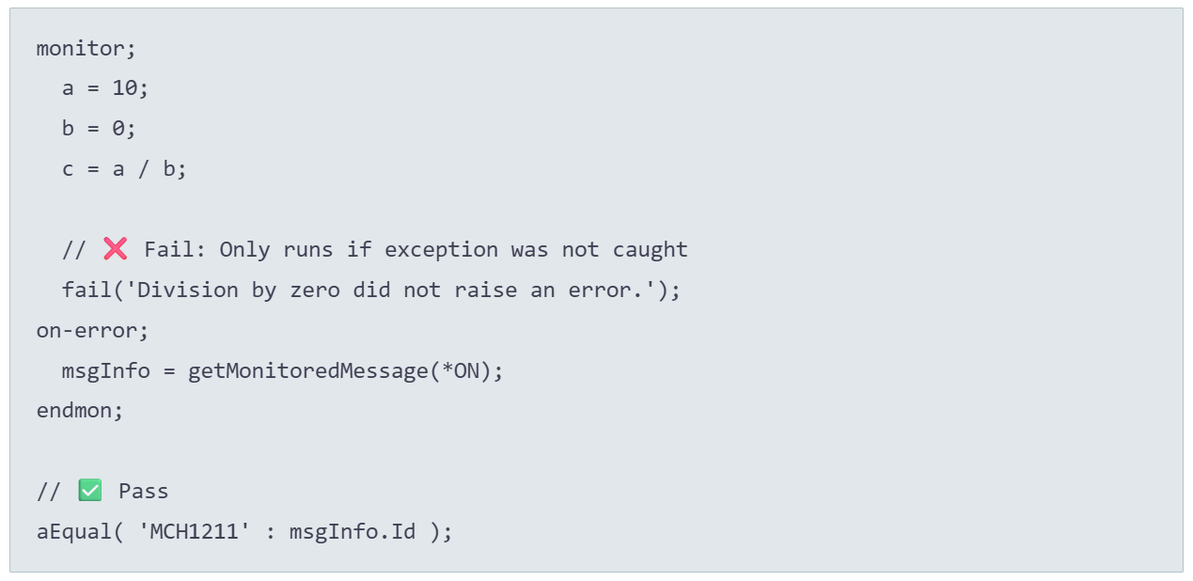
Assertions & utilities
💡Add the copybook: /include qinclude,TESTCASE
Example Assertions:
Example Utilities:
Code Coverage

Slide 12
Set up and tear down
RUCALLTST
💡Add the copybook: /include qinclude,TESTCASE
Unit Test Suite
setUpSuite()
setup()
For Each Test Case
testWhatever()
teardown()
Code Coverage
tearDownSuite()
End

Slide 13
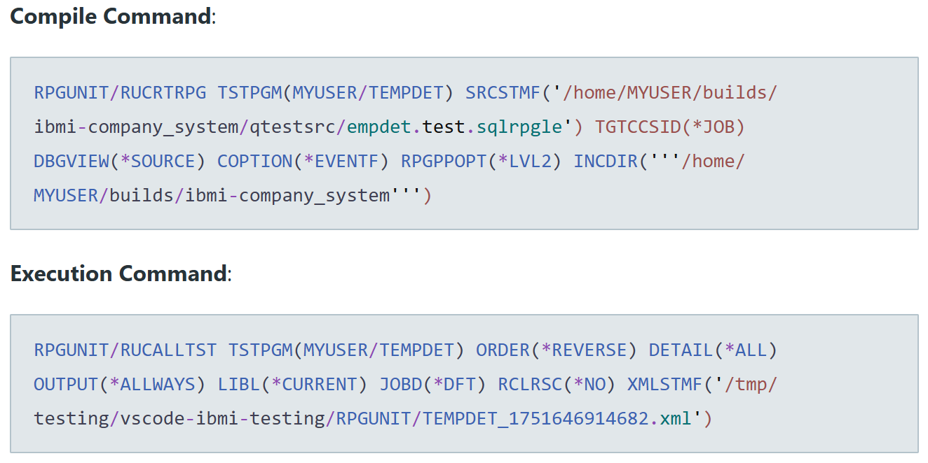
Compile and execution commands
Code Coverage

Slide 14
IBM i Testing Extension Demo

Slide 15
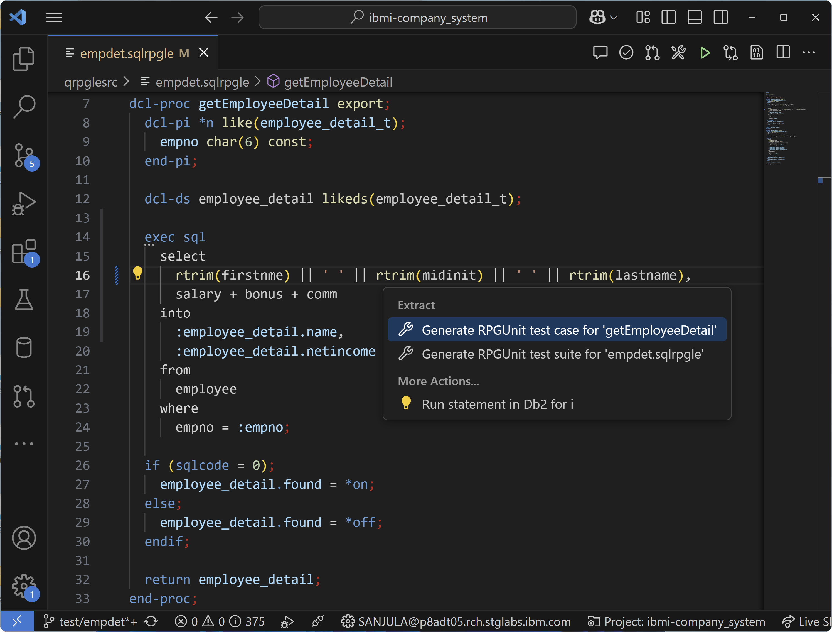
Generating test stubs

Slide 16
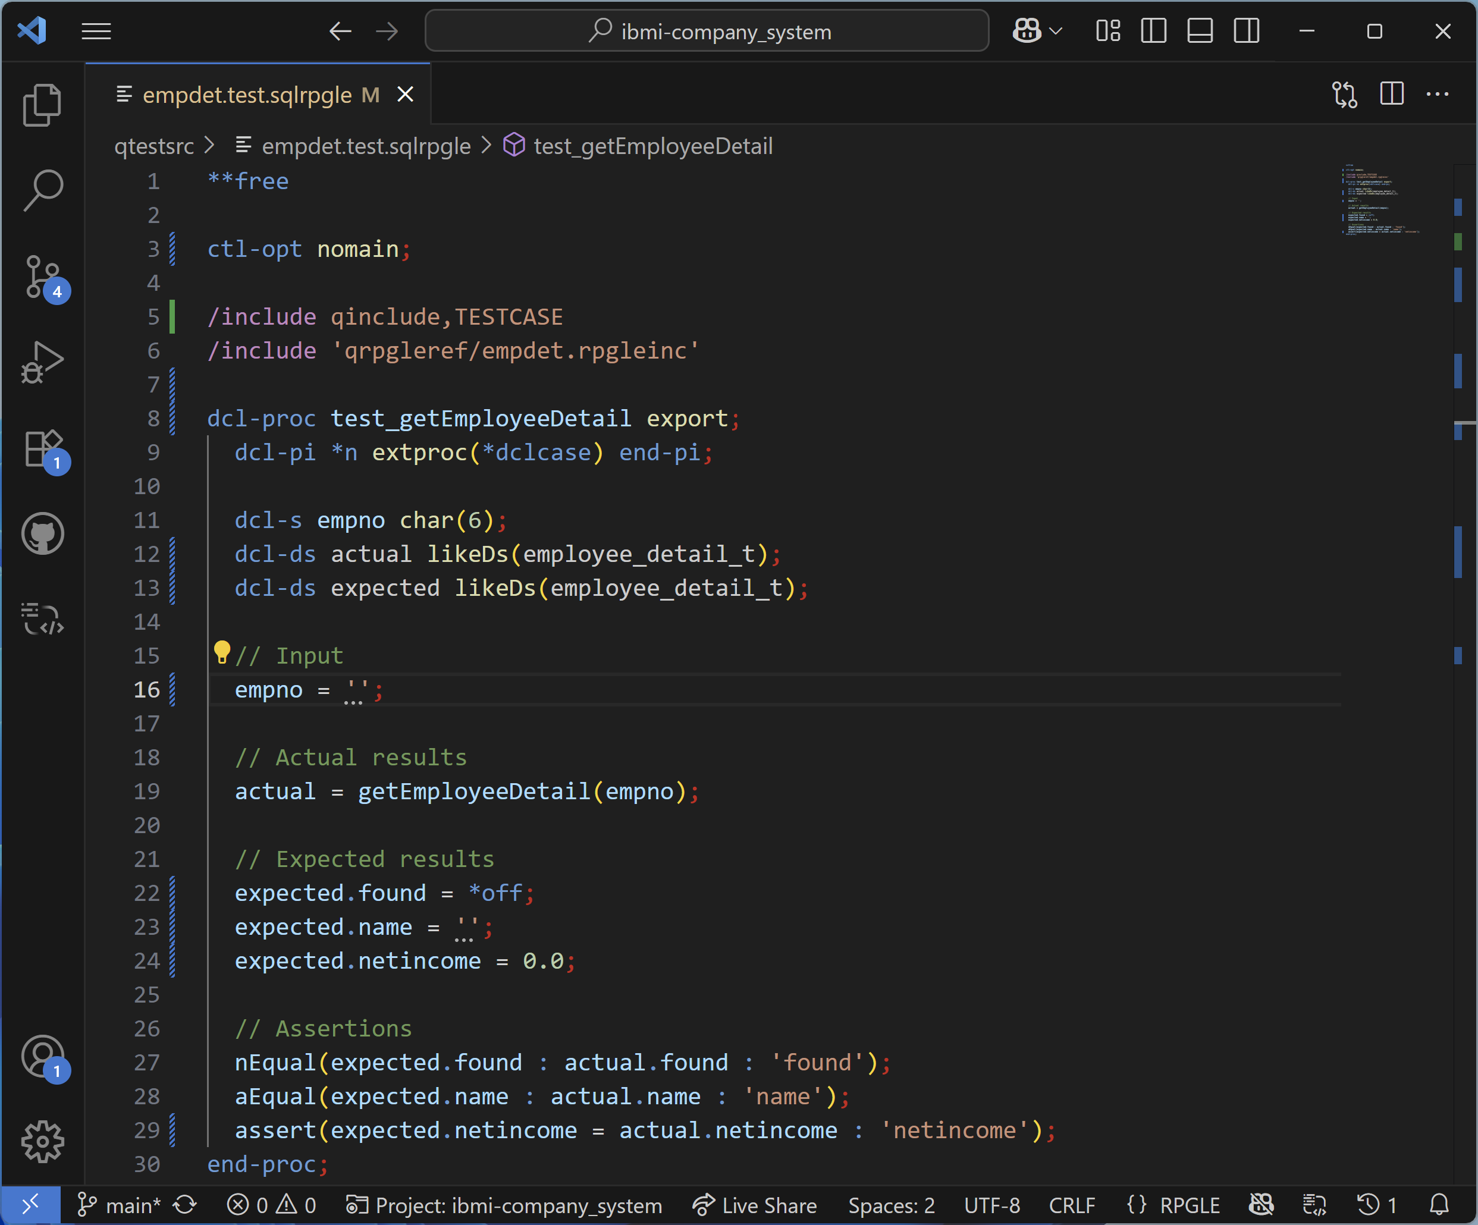
Generating test stubs

Slide 17
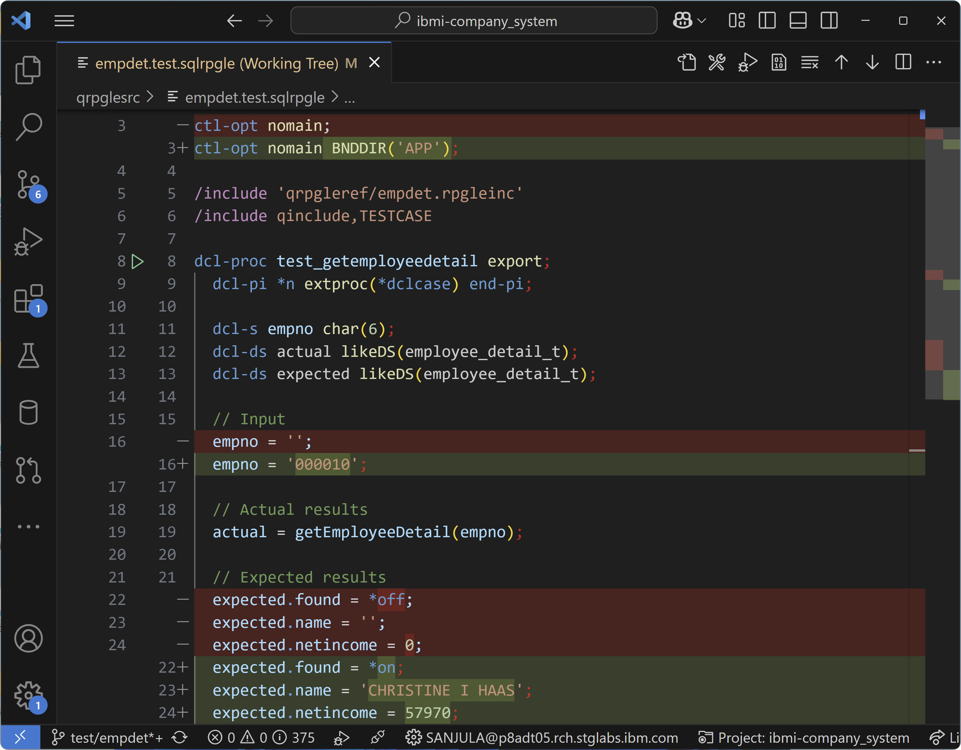
Writing tests

Slide 18
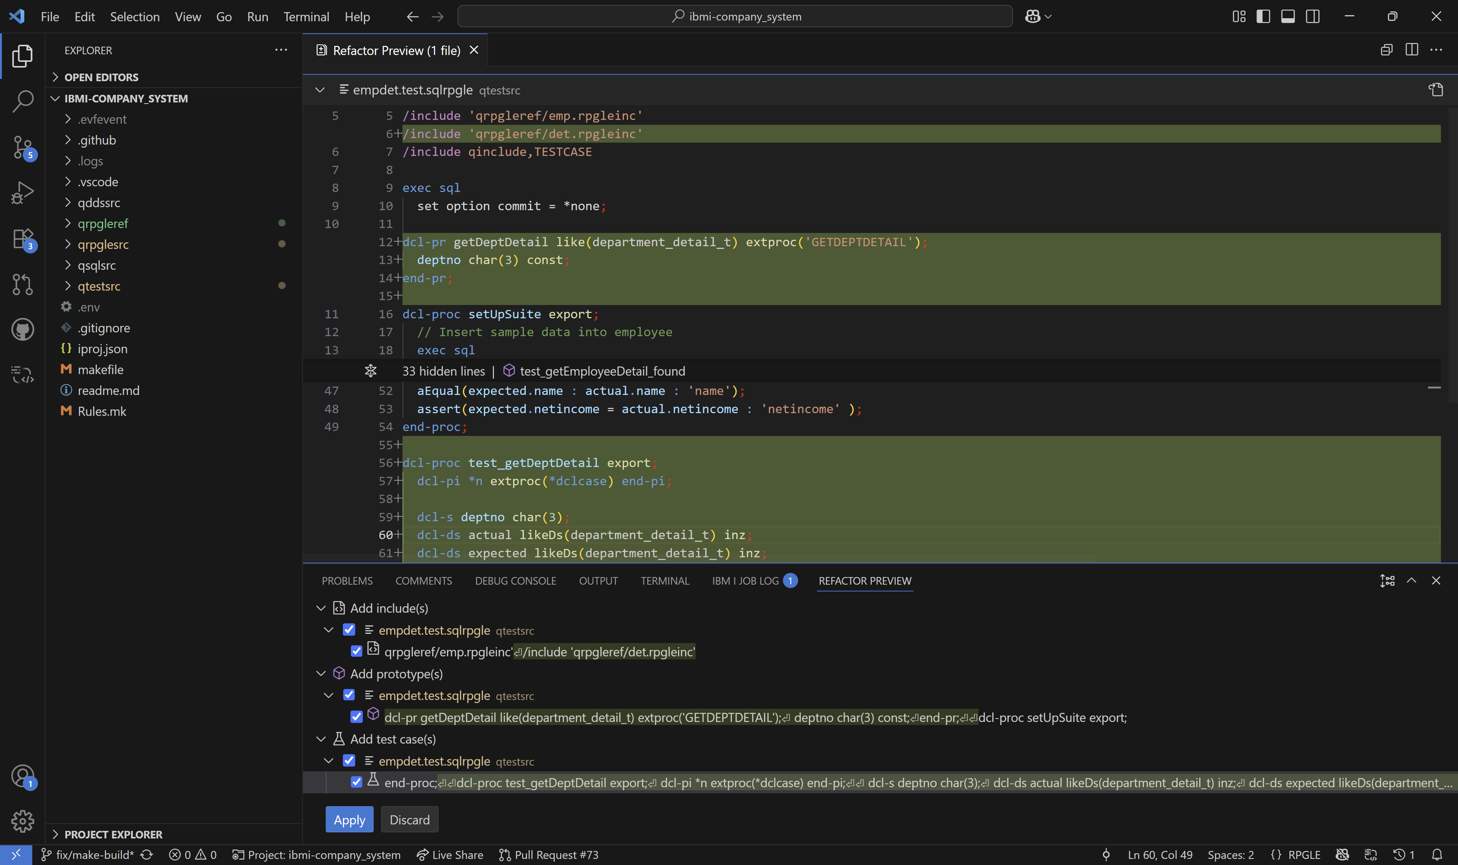
Generating more test stubs (preview mode)

Slide 19
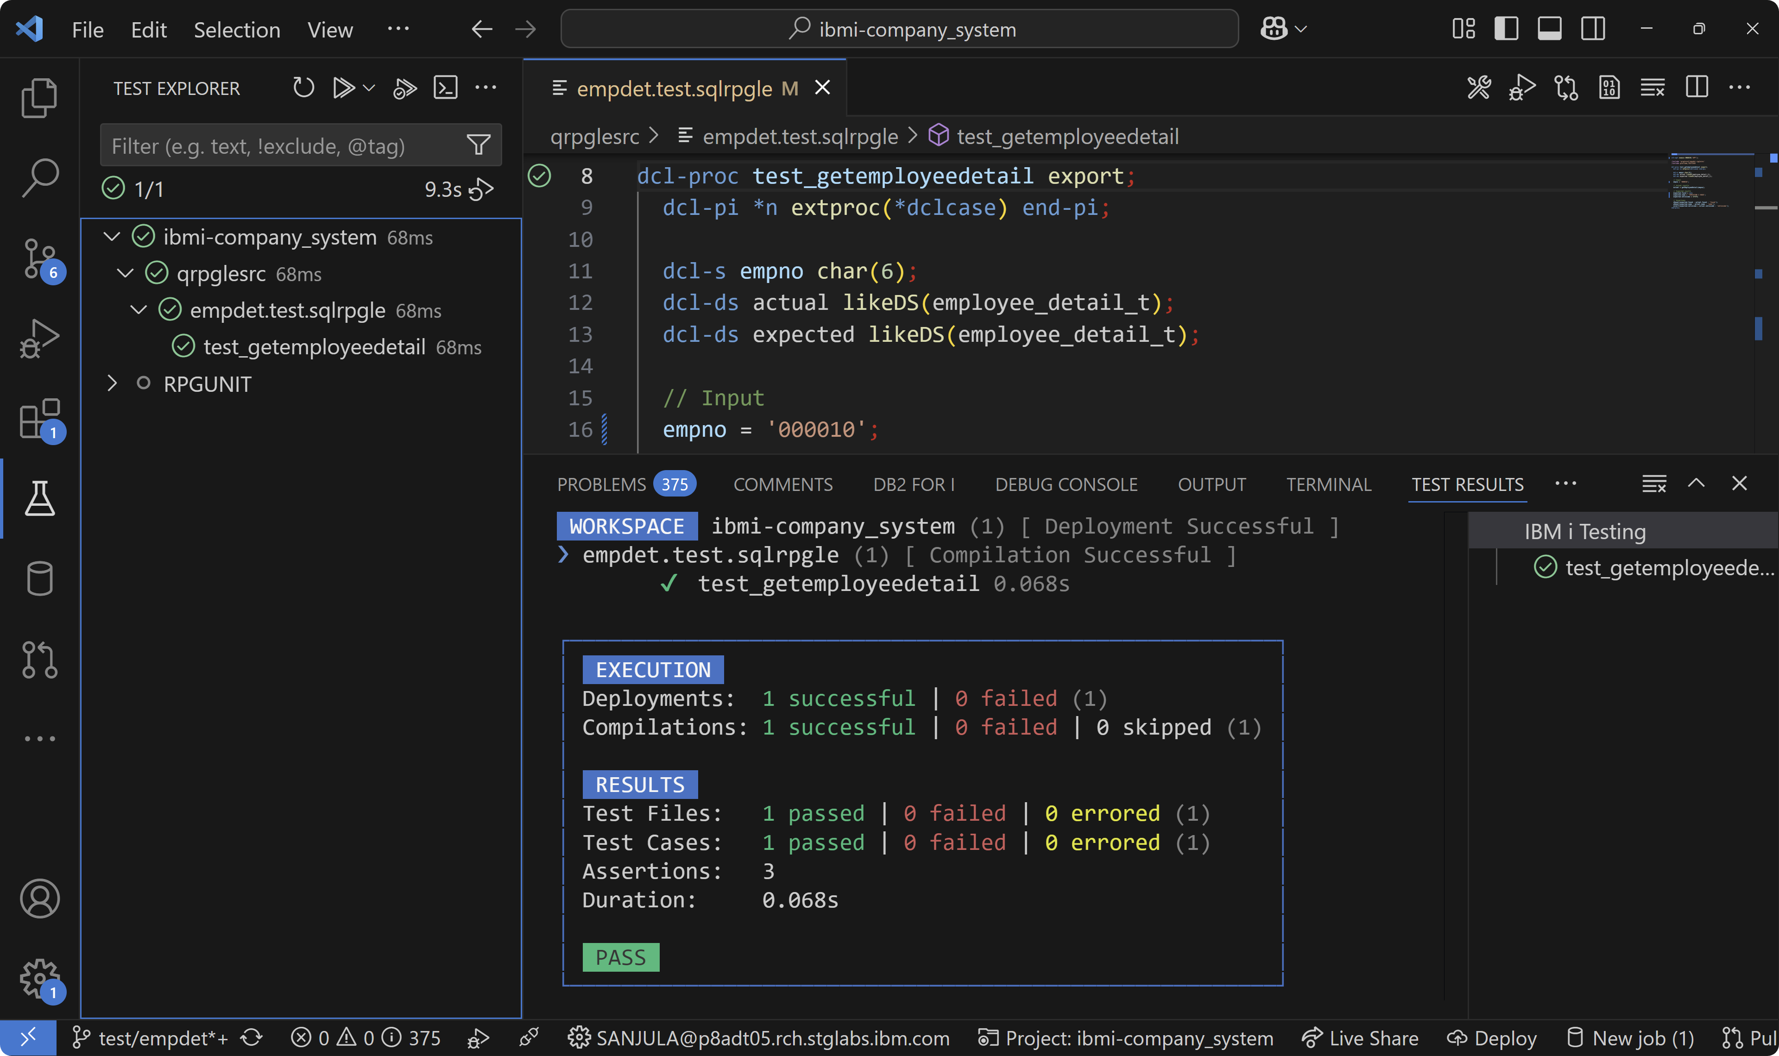
Running unit tests

Slide 20
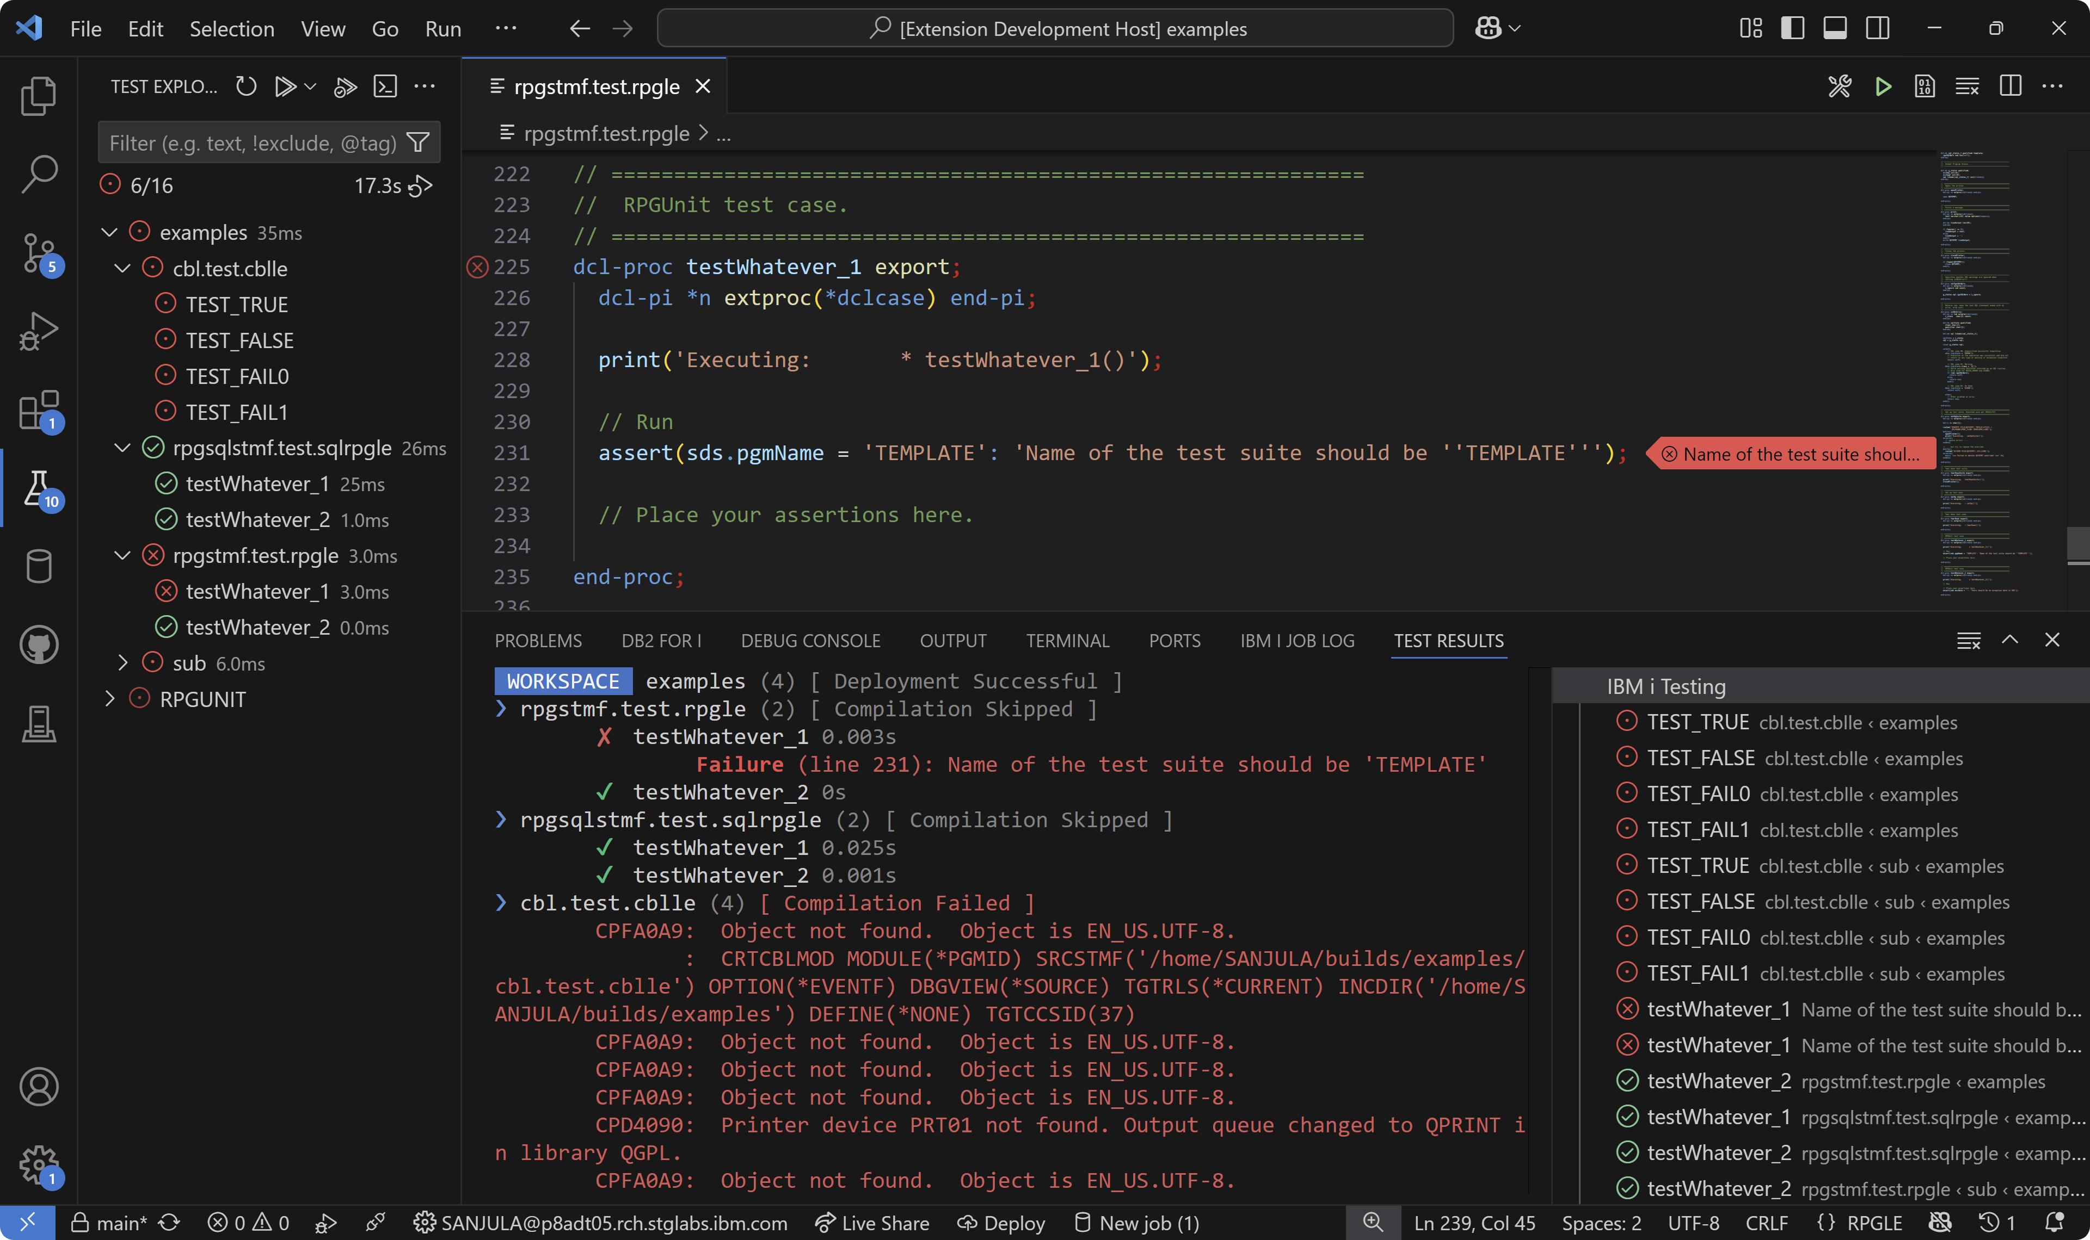
Viewing failures and errors

Slide 21
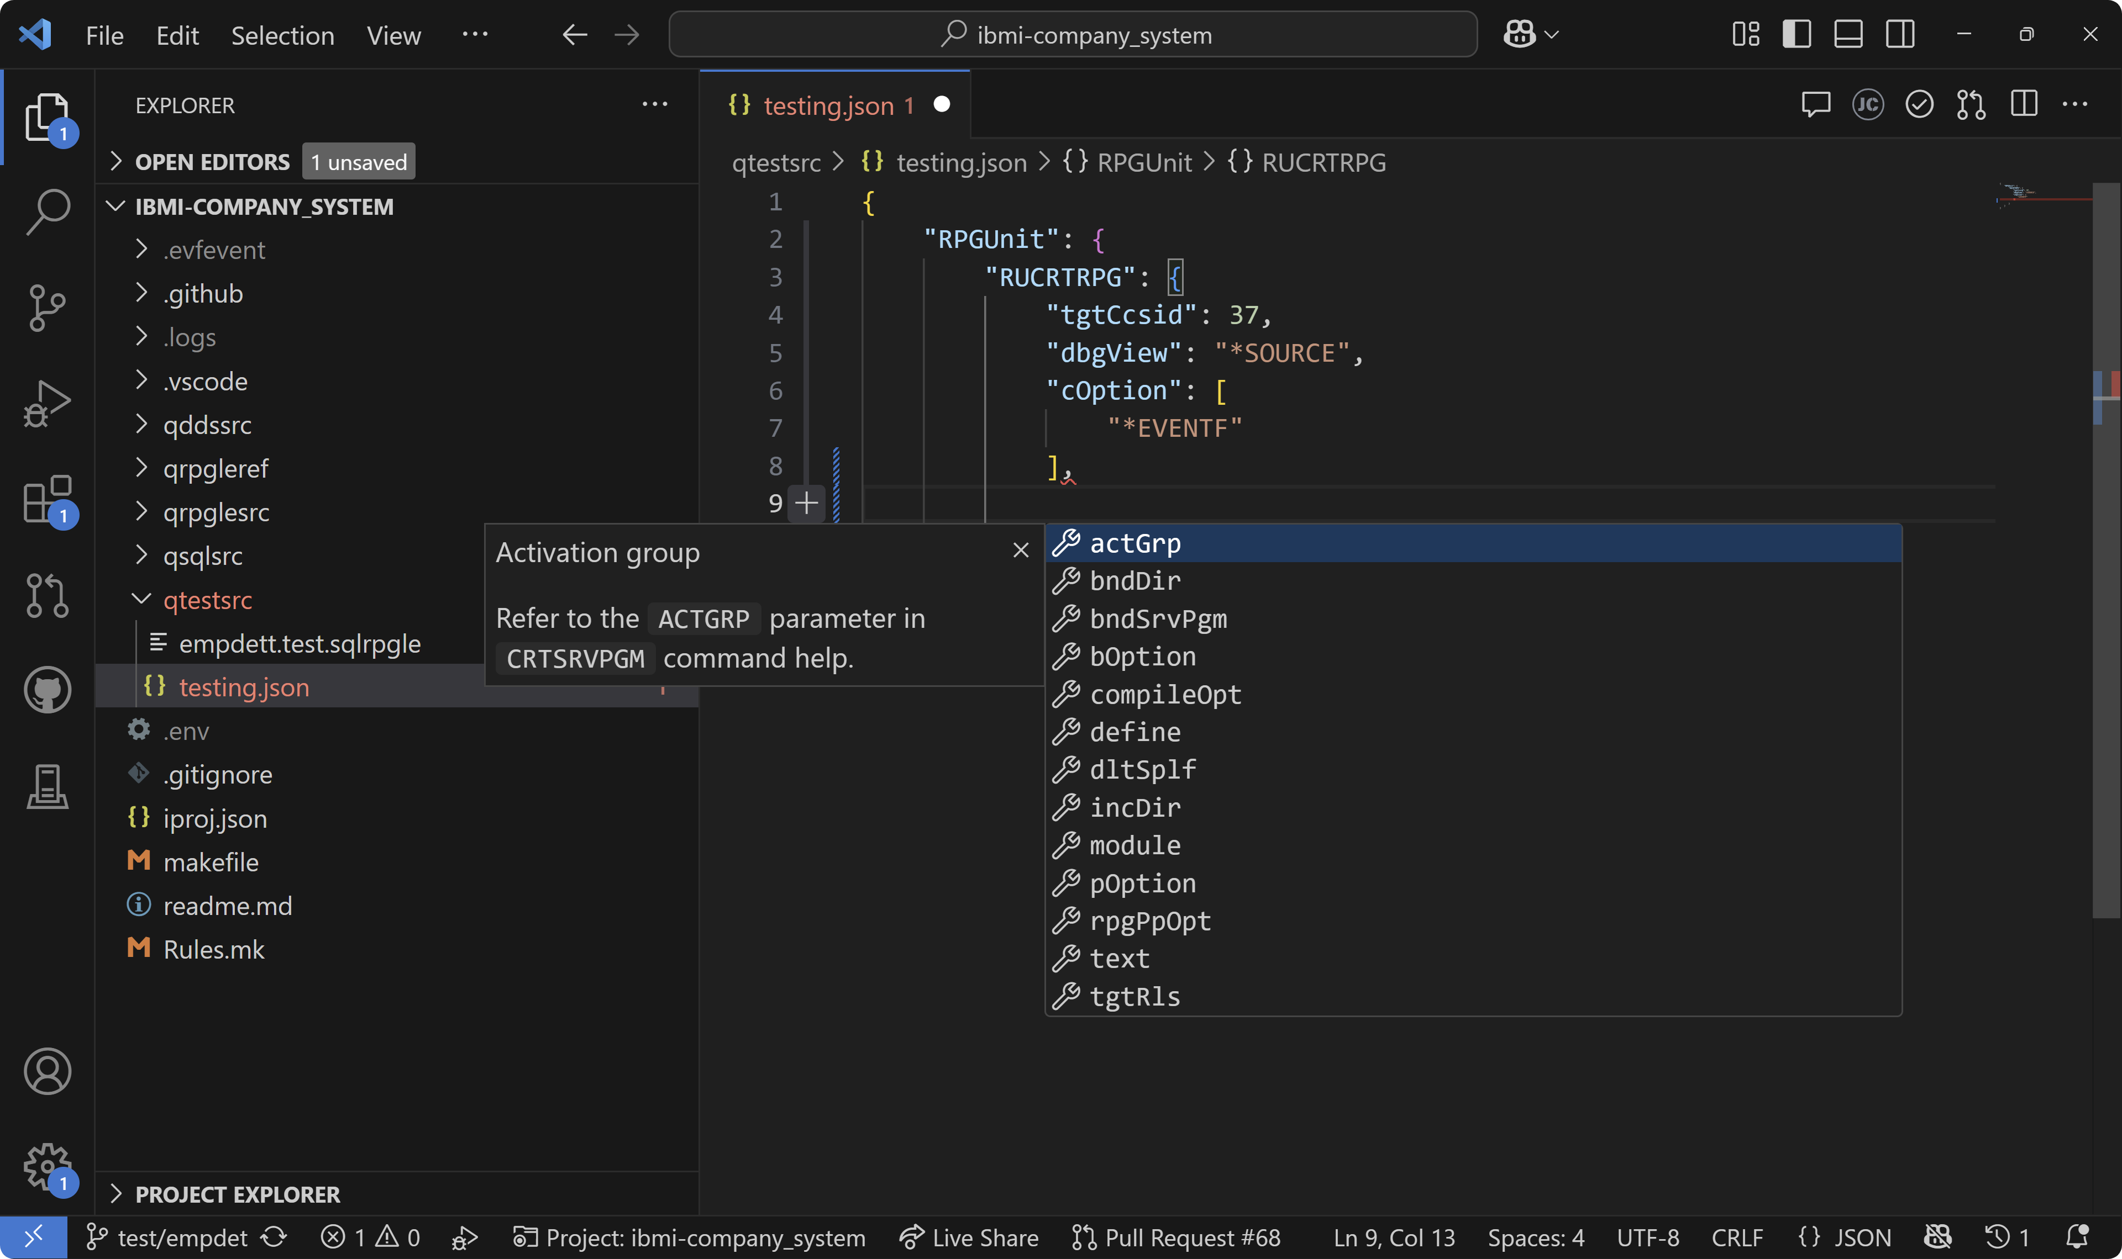
Configuring tests

Slide 22
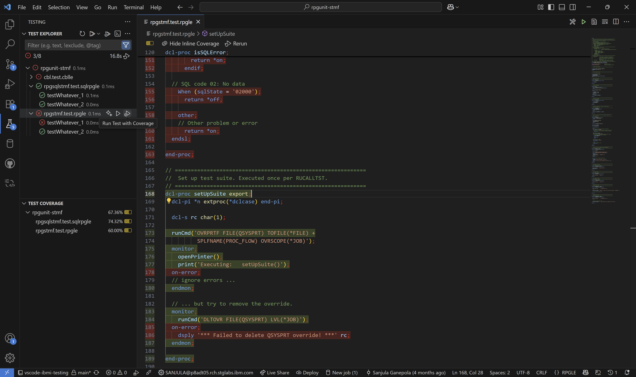
Generating code coverage

Slide 23
IBM i Testing CLI Demo (Soon To Be Released)

Slide 24
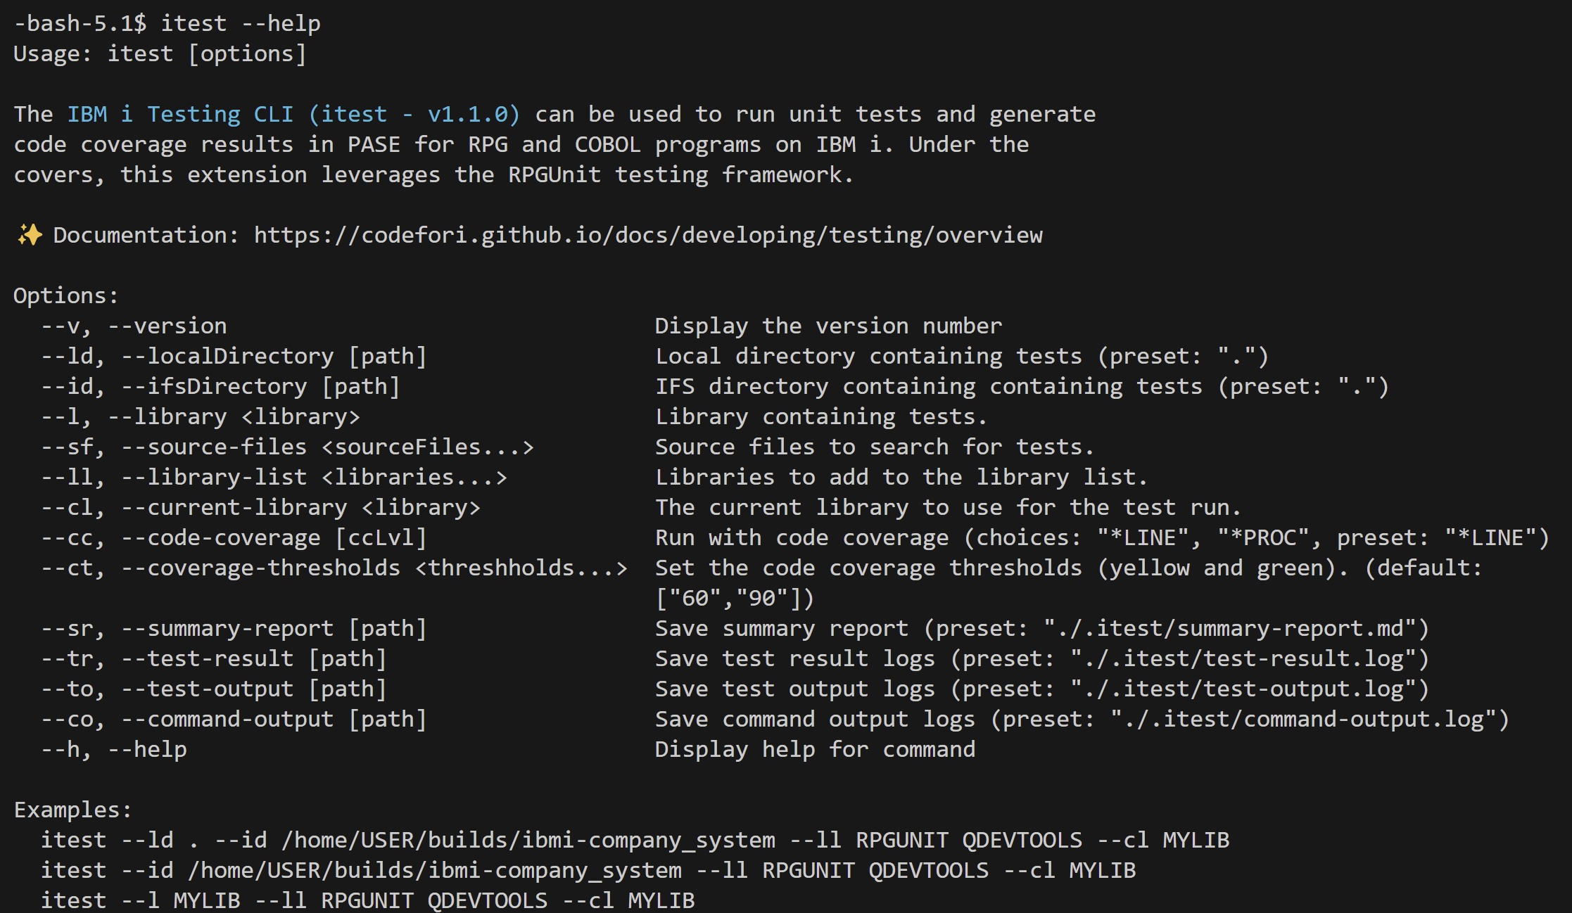
Running tests from a local terminal or in PASE on IBM i

Slide 25
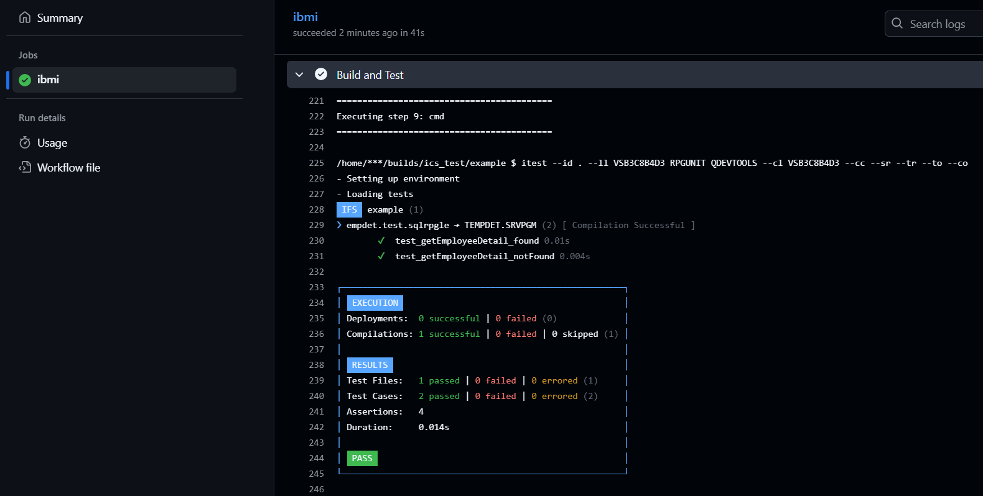
Running tests and code coverage in a pipeline

Slide 26
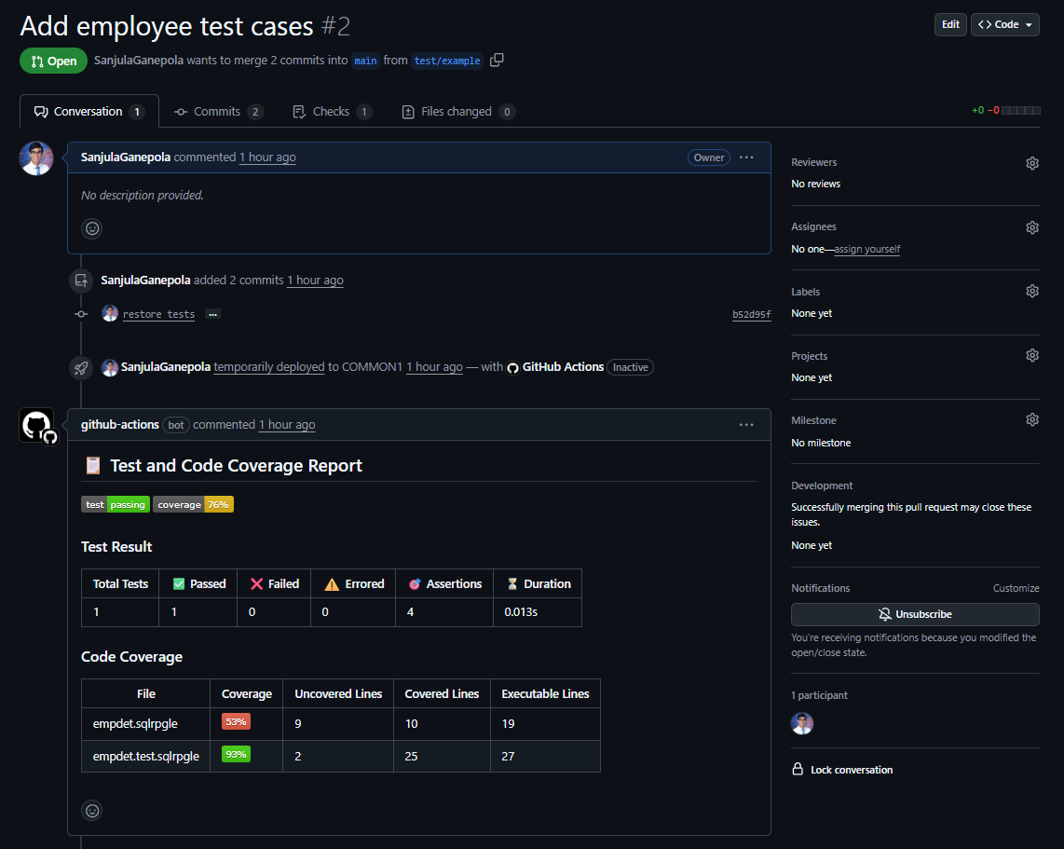
Viewing test and code coverage results

Slide 27
Important Links
IBM i Testing
VS Code Marketplace https://marketplace.visualstudio.com/items?itemName=IBM.vscode-ibmi-testing
Documentation https://codefori.github.io/docs/developing/testing/overview/
GitHub Repository https://github.com/IBM/vscode-ibmi-testing
RPGUNIT
Documentation https://irpgunit.sourceforge.io/help/
GitHub Repository https://github.com/tools-400/irpgunit
Sample Projects
Company System Demo https://github.com/IBM/ibmi-company_system
RPGUTILS https://github.com/IBM/vscode-ibmi-testing/tree/main/examples/rpg-utils
VS Code
Documentation https://code.visualstudio.com/docs/editor/testing

